Slide 1


Snehit Dua
11-09-22

Slide 2

Outline
Executive Summary
Introduction
Methodology
Results
Conclusion
Appendix

Slide 3
Executive Summary
Summary of methodologies
Data Collection
Data Wrangling
Exploratory Data Analysis with Data Visualization
Exploratory Data Analysis with SQL
Build an Interactive Map with Folium
Build a Dashboard with Plotly Dash
Predictive Analysis (Classification)
Summary of all results
Exploratory Data Analysis Results
Interactive Analytics Demo in Screenshots
Predictive Analysis Results

Slide 4
Introduction
Project background and context
SpaceX advertises Falcon 9 rocket launches on its website with a cost of 62 million dollars; other providers cost upward of 165 million dollars each, much of the savings is because SpaceX can reuse the first stage. Therefore if we can determine if the first stage will land, we can determine the cost of a launch. This information can be used if an alternate company wants to bid against SpaceX for a rocket launch. We will predict if the Falcon 9 first stage will land successfully.
Problems to be answered:
What variables/features affect the successful landing of the first stage?
What is the best classification model for prediction of landing of first stage?
Does the rate of success increase over the years?
Does the current SpaceX’s launch sites have the ideal geographical locations?

Slide 5

Section 1

Slide 6
Methodology
Executive Summary
Data collection methodology:
The data was extracted from:
SpaceX API and Wikipedia (using web scrapping)
Perform data wrangling
The landing outcomes were classified as successful (1) and unsuccessful (0).
Perform exploratory data analysis (EDA) using visualization and SQL
Perform interactive visual analytics using Folium and Plotly Dash
Perform predictive analysis using classification models
All the four Classification Models were trained on 80% of the data using the best parameters using GridSearchCV and the model with the best accuracy was selected.

Slide 7
Data Collection
The final dataset is comprised of data tables from SpaceX API (an API publicly available with records of the launches of SpaceX) and SpaceX’s Wikipedia page.
Following are the data columns derived from the above two sources:
SpaceX API:
'FlightNumber', 'Date', 'BoosterVersion', 'PayloadMass', 'Orbit', 'LaunchSite', 'Outcome', 'Flights', 'GridFins', 'Reused', 'Legs', 'LandingPad', 'Block', 'ReusedCount', 'Serial', 'Longitude', 'Latitude’
Wikipedia:
'Flight No.', 'Launch site', 'Payload mass', 'Orbit', 'Customer', 'Payload', 'Launch outcome', 'Version Booster', 'Booster landing', 'Date', 'Time'

Slide 8
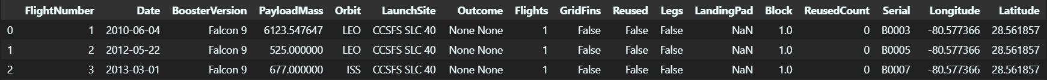
Data Collection – SpaceX API
Notebook
Request made to the API (“https://api.spacexdata.com/v4/launches/past”).
Response decoded as JSON to a pandas DataFrame.
Columns dropped to get resultant DataFrame with columns:
'rocket', 'payloads', 'launchpad', 'cores', 'flight_number', 'date_utc’.
Rows dropped with multiple cores and payloads (rockets with 2 extra boosters).
Several requests made to get details needed from the ids in the DataFrame.
Data filtered to include only Falcon 9 launches.
Replaced missing values of Payload Mass with mean value.
Resultant DataFrame:

Slide 9
Data Collection - Scraping
Notebook
Request made to Wikipedia’s SpaceX page using HTTP GET method.
Response converted to BeautifulSoup object.
Required table from the html content saved into dictionary with Column Names as keys and its corresponding data as values.
Dictionary converted to pandas DataFrame.
Exported in CSV format.

Slide 10
Data Wrangling
Notebook
Landing Outcomes:
“True Ocean”- Successfully landed to a specific region of ocean.
“False Ocean”- Unsuccessfully landed to a specific region of ocean.
“True RTLS”- Successfully landed to ground pad.
“False RTLS”- Unsuccessfully landed to ground pad
“True ASDS”- Successfully landed to drone ship.
“False ASDS”- Unsuccessfully landed to drop ship.
“None ASDS”- Failure to land.
“None None”- Failure to land.
mapped into Classes: Successful (1) and Unsuccessful (0).
“True Ocean”, “True RTLS” and “True ASDS” considered Successful Outcomes.

Slide 11
EDA with Data Visualization
Notebook
Charts Plotted:
Scatter Chart: Flight Number Vs Payload Mass, Flight Number Vs Launch Site, Payload Mass vs Launch Site, Flight Number Vs Orbit Type and Payload Mass Vs Orbit Type.
Bar Chart: Orbit Type Vs Success Rate.
Line Chart: Success Rate Yearly Trend.
Scatter Chart can be used to determine the relationships b/w variables which can be further used in Machine Learning Model.
Bar Chart show comparison among discrete categories.
Line Chart show trends in data over time.

Slide 12
EDA with SQL
Notebook
SQL Queries performed to:
Display the names of the unique launch sites in the space mission.
Display 5 records where launch sites begin with the string 'CCA'
Display the total payload mass carried by boosters launched by NASA (CRS)
Display average payload mass carried by booster version F9 v1.1
List the date when the first successful landing outcome in ground pad was achieved.
List the names of the boosters which have success in drone ship and have payload mass greater than 4000 but less than 6000
List the total number of successful and failure mission outcomes
List the names of the booster versions which have carried the maximum payload mass.
List the records which will display the month names, failure landing outcomes in drone ship ,booster versions, launch site for the months in year 2015.
Rank the count of successful landing outcomes between the date 04-06-2010 and 20-03-2017 in descending order.

Slide 13
Build an Interactive Map with Folium
Notebook
All Launch Sites marked on an interactive map using circles to show proximity to equator and coast.
Marked successful/failed launches for each site on map using marker cluster, where:
Green marker -> success
Red marker -> fail
Marked distances using polylines between a Launch Site and its proximities (Coast Line, Highway and City) to answer following questions:
Are launch sites in close proximity to railways?
Are launch sites in close proximity to highways?
Are launch sites in close proximity to coastline?
Do launch sites keep certain distance away from cities?

Slide 14
Build a Dashboard with Plotly Dash
Code File
Dropdown to select a Launch Site (default: All Sites).
Pie Chart to show success launches of each sites (All Sites) or success vs fail launches (Specific Site).
Slider to select Payload Mass (kg) range.
Scatter Chart to show Payload Mass Vs Success Rate for different Booster Versions for the selected Launch Site within the selected Payload Mass range.

Slide 15
Predictive Analysis (Classification)
Notebook
Independent Variables (X) and Dependent Variables (Y) separated (Y being ‘Class’).
Standardized X using Standard Scaler.
Data divided into 2 parts: Train and Test Data using Train Test Split (test size being 20%).
GridSearchCV object created with cv = 10 to find best parameters for all the Classification Models.
Accuracies (.score, Jaccard Score and F1 Score) on test and whole data separately calculated and compared for all the models.
Model with the best Accuracy chosen.

Slide 16
Results
Exploratory data analysis results
Interactive analytics demo in screenshots
Predictive analysis results

Slide 17

Section 2

Slide 18
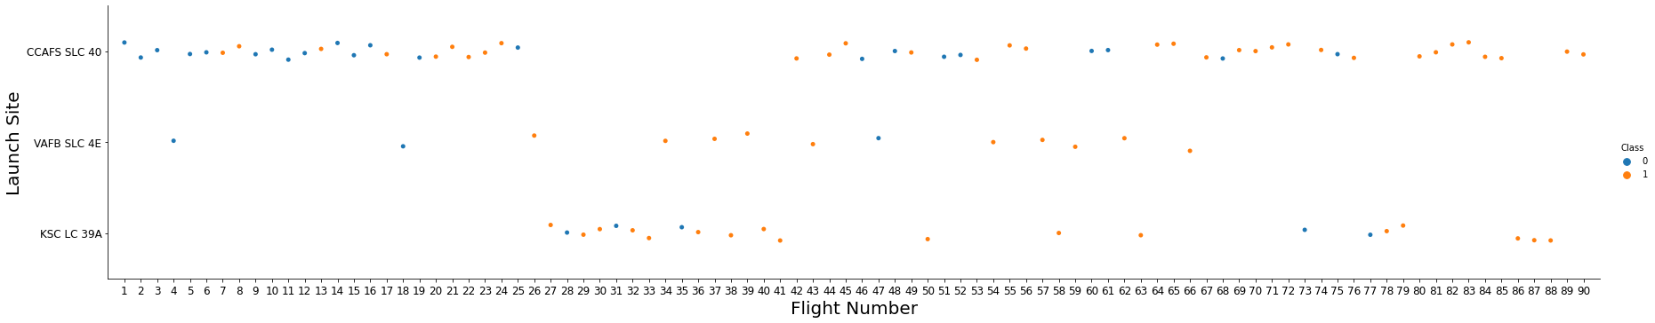
Flight Number vs. Launch Site
Explanation:
CCAFS SLC 40 is having the majority of launches while VAFB SLC 4E is having the least no. of launches.
KSC LC 39A is having the highest success rate followed by VAFB SLC 4E.
Newly launched flights have higher success rate as compared to the earliest ones.

Slide 19
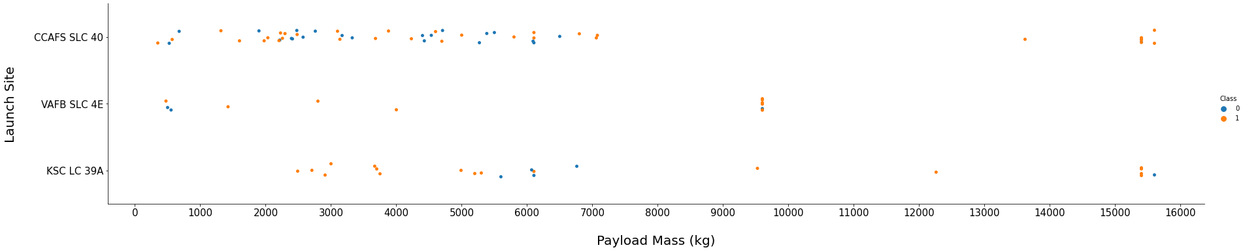
Payload vs. Launch Site
Explanation:
Higher the Payload Mass higher the success rate.
Almost every launch with Payload Mass greater than 7000 is successful.
KSC LC 39A is the only site with 100% success rate for launches with Payload Mass less than 5500.

Slide 20
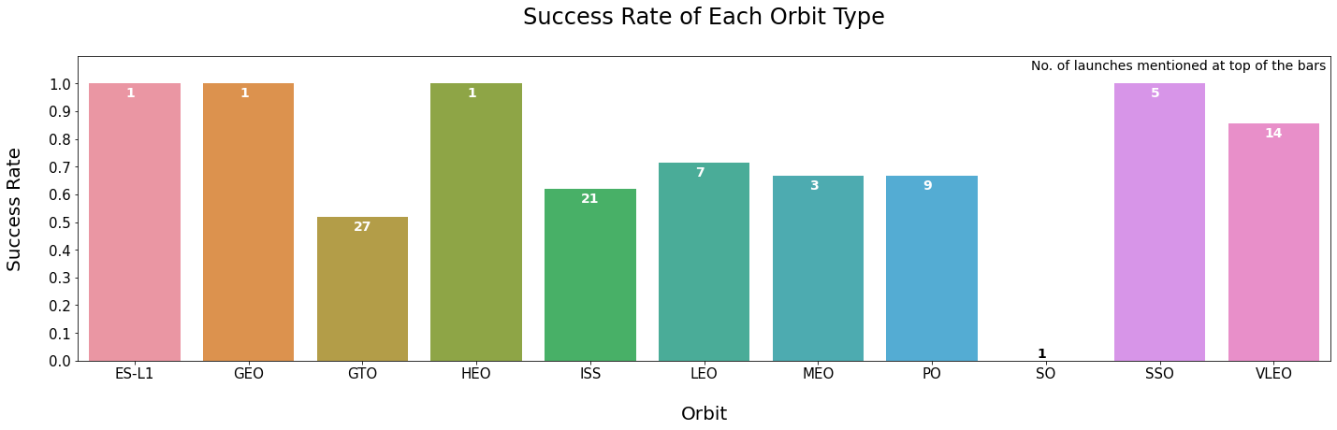
Success Rate vs. Orbit Type
Explanation:
Orbits with 100 % success rate: ES-L1, GEO, HEO and SSO.
Only 1 flight is launched per above mentioned orbit types except SSO.
SO is the only orbit type with 0% success rate but only 1 flight is launched with it.
GTO (50%) and ISS (60%) are only orbit types with highest launches.

Slide 21
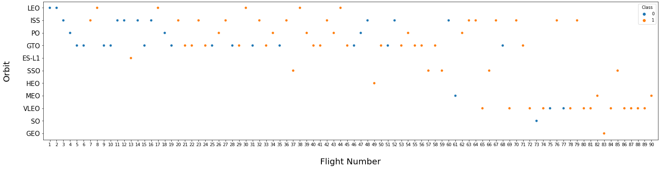
Flight Number vs. Orbit Type
Explanation:
Majority of new launches (60-90) are with orbit type VLEO with 85% success rate.
Majority of old launches (1-60) are with orbit type GTO.
In every orbit as the no. of flights increases; success rate also increases except in GTO.

Slide 22
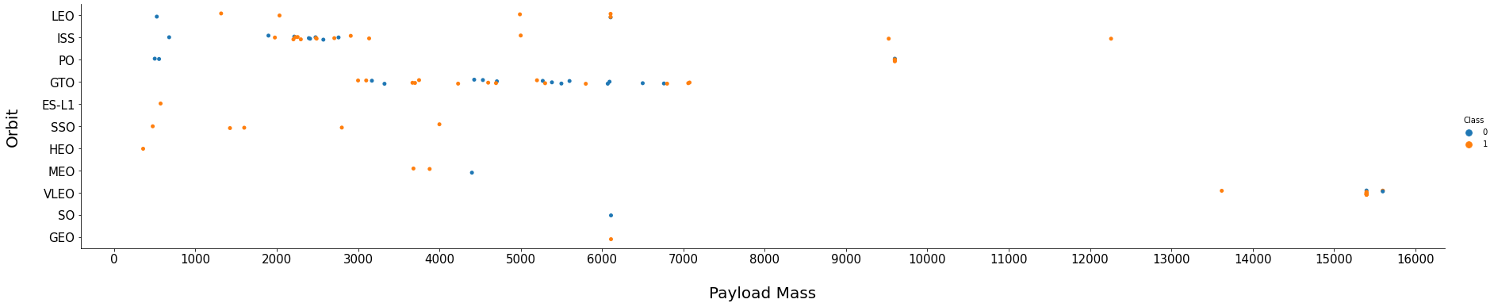
Payload vs. Orbit Type
Explanation:
LEO, PO and ISS have higher success rates with higher Payload Masses.
But GTO is not related with Payload Mass as it is having both success and fail landings.
SSO is having 100 % success rate in between low payload range of 0-4000.
VLEO appears to work better with higher payload ranges with 85% success.
We can’t say anything about other orbits as there is insufficient evidence.

Slide 23
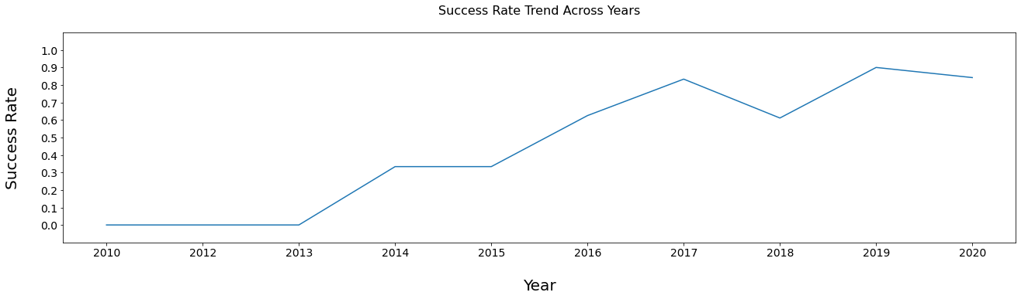
Launch Success Yearly Trend
Explanation:
The Success Rate in the initial years (2010-2013) remained same i.e. 0%.
The Success Rate kept increasing from 2013 till 2020 non uniformly.
Highest Success Rate in 2019 i.e. 90%.

Slide 24
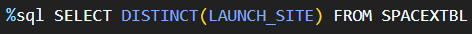
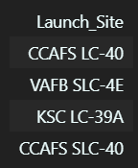
All Launch Site Names
Query:
Output:
Explanation:
Displaying the names of unique Launch Sites in the space Mission.

Slide 25
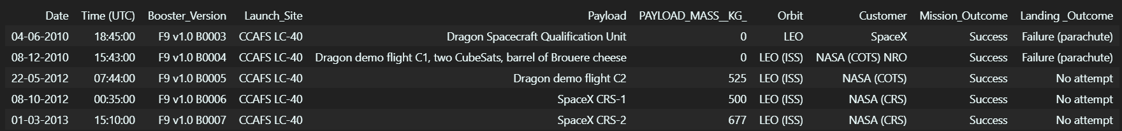
Launch Site Names Begin with 'CCA'
Query:
Output:
Explanation:
Displaying 5 records where Launch Sites begin with ‘CA’.

Slide 26
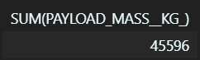
Total Payload Mass
Query:
Output:
Explanation:
Displaying the total payload carried by boosters from NASA.

Slide 27
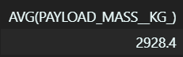
Average Payload Mass by F9 v1.1
Query:
Output:
Explanation:
Displaying the average payload mass carried by booster version F9 v1.1.

Slide 28
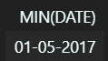
First Successful Ground Landing Date
Query:
Output:
Explanation:
Displaying the dates of the first successful landing outcome on ground pad.

Slide 29
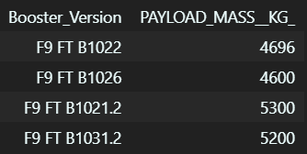
Successful Drone Ship Landing with Payload between 4000 and 6000
Query:
Output:
Explanation:
Displaying the names of boosters which have successfully landed on drone ship and had payload mass greater than 4000 but less than 6000.

Slide 30
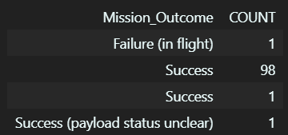
Total Number of Successful and Failure Mission Outcomes
Query:
Output:
Explanation:
Displaying the total number of successful and failure mission outcomes.

Slide 31
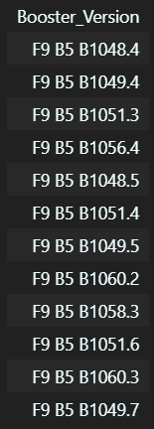
Boosters Carried Maximum Payload
Query:
Output:
Explanation:
Displaying the names of the booster which have carried the maximum payload mass.

Slide 32
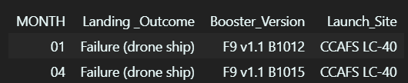
2015 Launch Records
Query:
Output:
Explanation:
Displaying the records which will display the months, failure landing outcomes in drone ship ,booster versions, launch site for the months in year 2015.

Slide 33
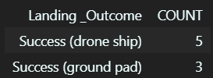
Rank Landing Outcomes Between 2010-06-04 and 2017-03-20
Query:
Output:
Explanation:
Displaying the count of successful landing outcomes between the date 04-06-2010 and 20-03-2017 in descending order.

Slide 34

Section 3

Slide 35
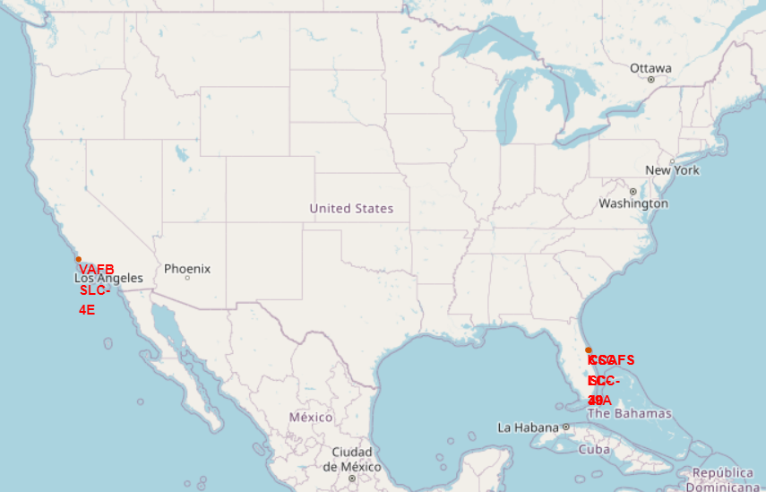
Launch Sites Locations
All the Launch Sites are in very close proximity to Coast as it reduces the risk of nearby people getting injured by the explosion.
All the Launch Sites are also in close proximity to Equator line as rockets get an additional natural boost that helps save the cost of putting in extra fuel and boosters.

Slide 36
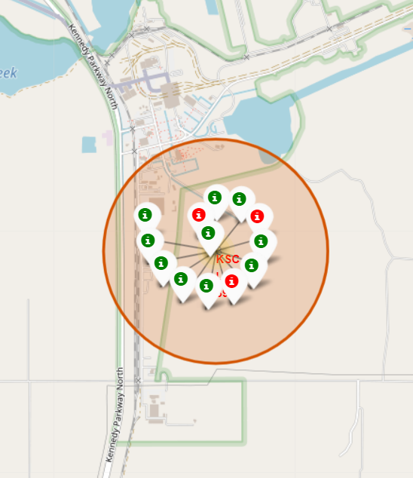
Color Labeled Launch Records
Color labeled markers shows the Launch Site’s launch records classified as:
Successful (Green Color)
Unsuccessful (Red Color)
KSC LC-39A is the Launch Site with Highest Success Rate.

Slide 37
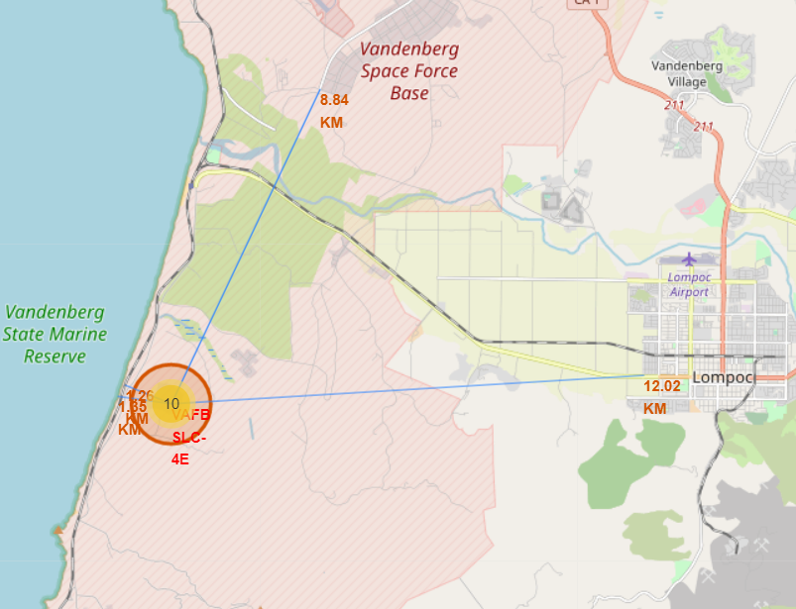
Distance From VAFB SLC-4E to its Proximities
From the map we can say that:
Launch Site is very close to Coast Line (1.35 KM) which is a good thing.
It is very close to Railway (1.25 KM) which is a very bad thing.
Highway and the closest city is little far i.e. 8.84 KM and 12.02 KM respectively but still failed rockets can cover a distance of 15-20 KM in few seconds.

Slide 38

Section 4

Slide 39
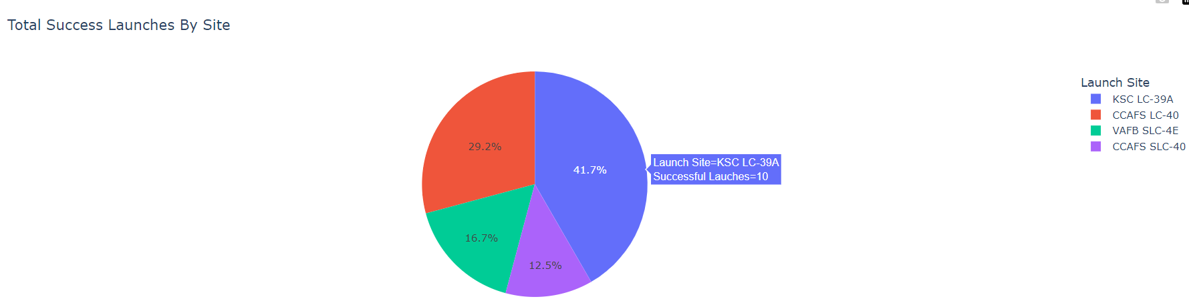
Total Successful Launches Per Launch Site
Explanation:
KSC LC-39A is having the highest no. of successful launches i.e. 10.
CCAFS SLC-40 is having the least no. of successful launches i.e. 3.

Slide 40
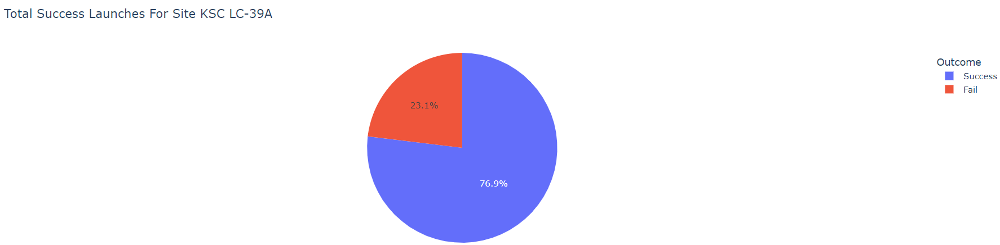
Launch Site with Highest Launch Success Ratio
Explanation:
KSC LC-39A is the Launch Site with Highest Launch Success Ratio with 10 successful and 3 unsuccessful landings.

Slide 41
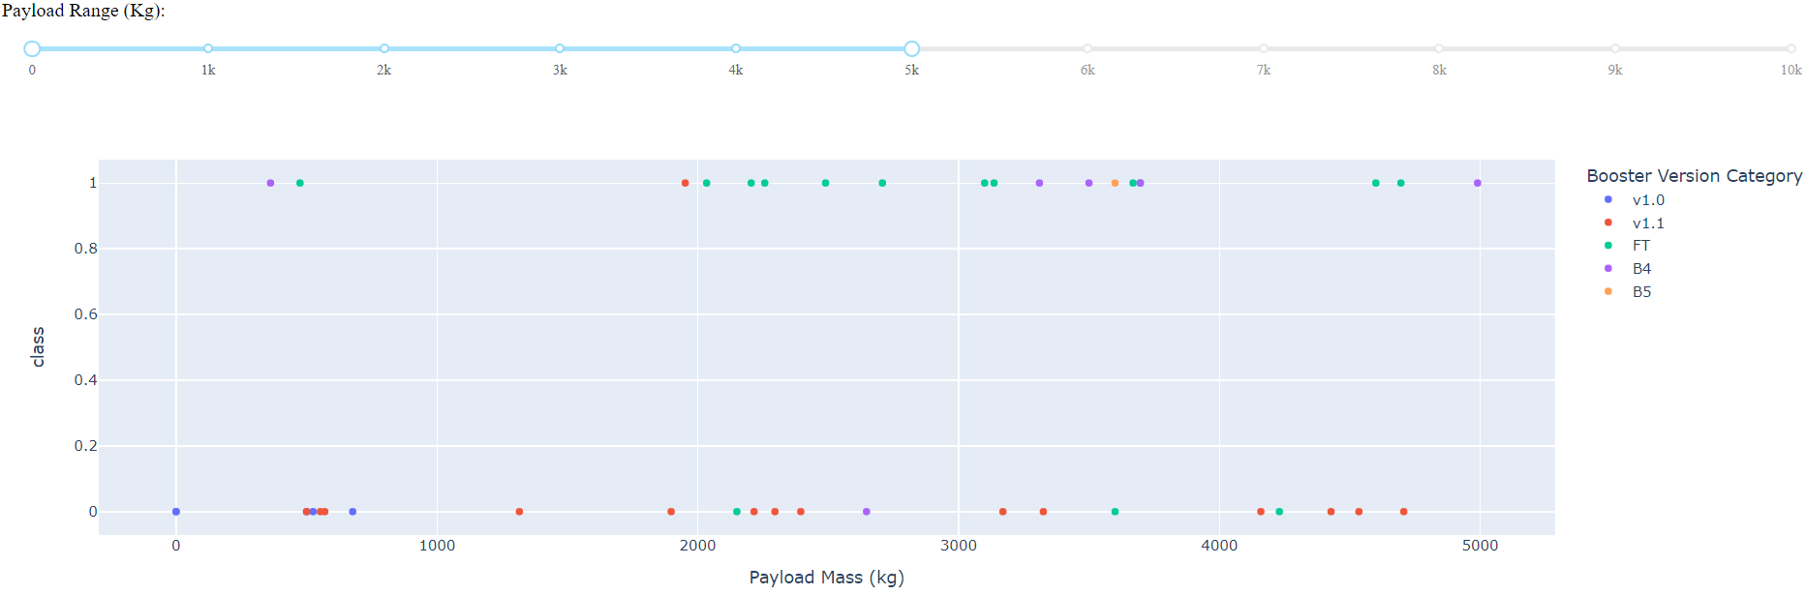
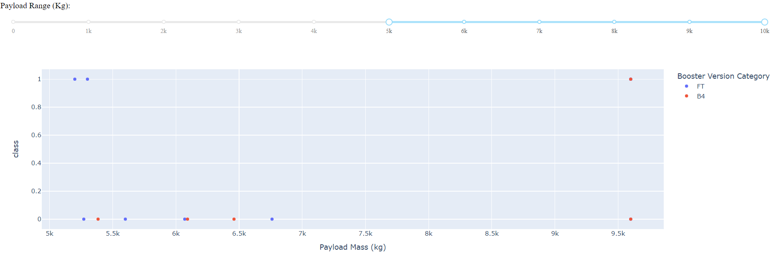
Payload Mass Vs Launch Outcome
Payload Mass in the range of 2000-5000 have the highest success rate.
Booster Version B5 have 100% success rate but it is used only in one flight.
We can say Booster Version v1.0 and v1.1 are the worst performing with 0% and 6% success rates for 4 and 15 flights respectively.
FT and B4 are the only boosters used with payload above 5000 but these works better in below 5000 with 80% and 83% success rate as compared to 44% and 20% (in higher range).

Slide 42

Section 5

Slide 43
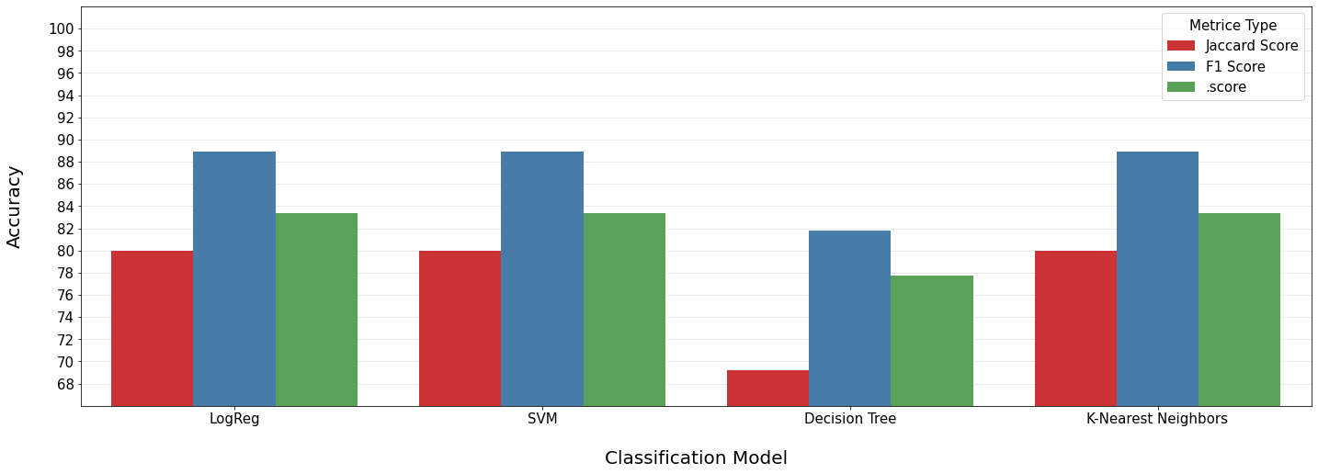
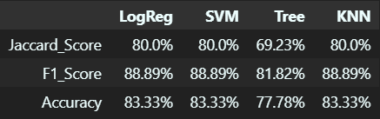
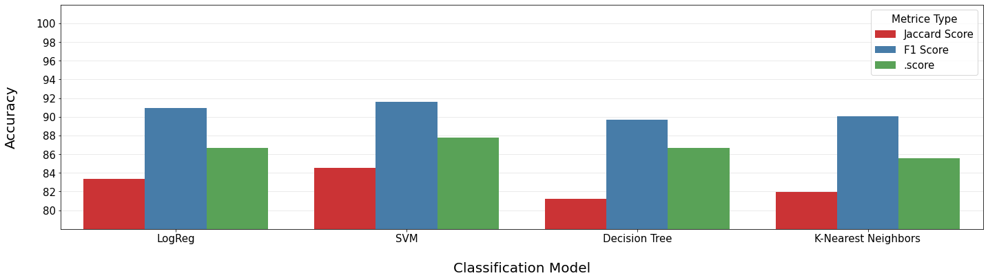
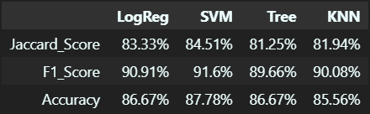
Classification Accuracy
On Test Data:
On Entire Dataset:

Slide 44
Classification Accuracy
Explanation:
All the Classification Models when tested on the test data (20% of entire dataset) produced the same accuracy except Decision Tree; so, it is not clear which one is the best one.
Testing upon the entire dataset, we can say that Support Vector Machine is the best Classification Model as it is the one with highest accuracy tested with all the 3 metrices.

Slide 45
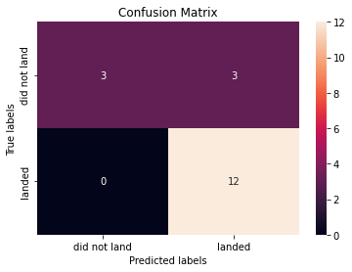
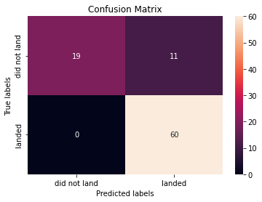
Confusion Matrix
Test Data Whole Data
Explanation:
On examining we can say that our model is pretty accurate but the main problem is false positives.

Slide 46
Conclusions
Newly launched flights have higher success rate as compared to the earliest ones.
Success Rate is low for higher Payload Mass as compared to lower.
Orbit Types: SSO and VLEO are the best orbits with 100% and 85% success rate with 5 and 15 total launches respectively.
Orbit Type VLEO works better with higher payload ranges (>13000) with 85% success.
Success Rate keeps increasing as the years progresses.
Launch Sites are in close proximity to Coast and Equator Line (pro).
Launch Sites are in close proximity to Railway, Highway and City (con).
KSC LC-39A is the Launch Site with Highest Success Rate.
Payload Mass in the range of 2000-5000 have the highest success rate.
Worst performing Booster Versions: v1.0 and v1.1.
Booster Versions: FT and B4 works better with lower payload range (<5000) as compared to higher.
Support Vector Machine is the best Classification Model in our case.

Slide 47
Appendix
Created Jupyter Notebooks:
API Data Collection
Web Scraping
Data Wrangling
EDA With SQL
Data Visualization
Launch Site Location Analysis
Machine Learning Model

Slide 48


